Slide 1
INTRODUCTION TO MARKETING
0
Chapter 3
The Cultural Environment
NGUYEN THI PHUONG*
THANG LONG UNIVERSITY
*MA in Global Marketing, PHD in Economics

Slide 2
SESSION 2: Marketing strategy
1
what marketing strategy and marketing strategy planning are
2
target marketing and the four Ps in the marketing mix
3
4
difference between a marketing strategy, a marketing plan and a marketing program
marketing opportunities that help in identifying new strategies

Slide 3
Marketing management process
The marketing management process: is the process of (i) planning marketing activities (marketing planning), (ii) directing the implementation of the plans and (iii) controlling these plans.
strategic (management) planning: the job of planning strategy to guide a whole company. It includes planning not only for marketing but also for production, finance, human resources and other areas

Slide 4
Marketing management process
Maketing planning
Set objectives
Implement marketing plans
Implement marketing plans and programs
Controlling marketing plans
Measure results
Evaluate opportunities
Create marketing strategy
Prepare marketing plans
Develop marketing programs
Evaluate progress

Slide 5
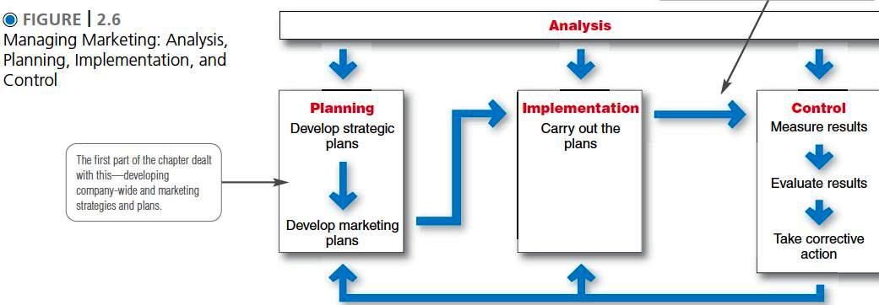

Slide 6
2.1 Marketing strategy planning and marketing strategy
Marketing strategy planning: finds attractive opportunities and developing profitable marketing strategies
Marketing strategy: specifies a target market and a related marketing mix. It is a big picture of what a firm will do in some markets
A target market: a fairly homogeneous group of customers to whom a company wishes to appeal
A marketing mix: the controllable variables the company puts together to satisfy this target group

Slide 7
2.2 Target marketing and marketing mix
Target marketing is selecting a marketing strategy that specifies some particular target customers
“target marketing” is “mass marketing”?
Mass-marketing is the typical production-oriented approach aims at every one with the same marketing mix. Mass marketing means trying to sell to everyone
For ex: beauty products (foundation) for all skin types, carbonated beverage products (Cococola)
Notes:
selecting a market-oriented strategy is target marketing

Slide 8
Target marketing
Target marketing is not limited to small market segments
For example: baby diapers and diapers for elderly people
For children: Kimberly-Clark (Huggies) and P&G (Pampers)
For elderly people: Caryn
Notes:
Target marketing is not limited to small market segments. A very large market may be fairly homogeneous and a target marketer will aim at it. For example, a very large group of parents of young children are homogeneous on many dimensions, including their attitudes about changing baby diapers. On the other hand, many elderly people, especially those who are in nursing home and have mobility problems, use diapers in different forms and sizes. The marketing mix for babies isn’t right for elderly people.

Slide 9
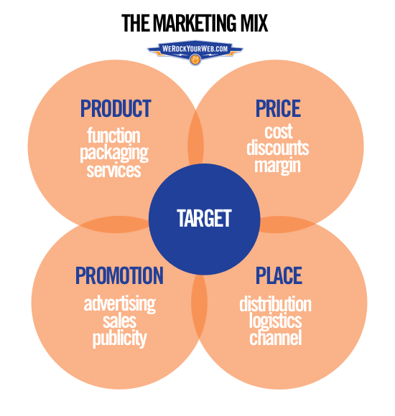
Marketing mix
The customer should be the target of all marketing efforts.

Slide 10
Product: is concerned with developing the right product for the target market. Along with product area is other decisions like branding, packaging and warranties
Place: is concerned with all the decisions involved in getting the “right” product to the target market’s place. A product reaches customers through a channel of distribution (online website, retailers and wholesalers)

Slide 11
Promotion: is concerned with telling the target market or others in the channel of distribution about the right product. Promotion includes personal selling, mass selling and sales promotion
Price: must consider the kind of competition in the target market and the cost of the whole marketing mix (markups, discounts and other terms of sales)

Slide 12
Strategy decision by the four Ps
Product
Physical good
Branding
Place
Objectives
Managing channels
Price
Objectives
Promotion
Service
Features
Benefts
Quality level
Accessories
Installation
Instructions
Warranty
Product lines
Packaging
Channel type
Market exposure
Kinds of middlemen
Kinds and locations of stores
Transporting and storing
Service levels
Recruiting middlemen
Objectives
Promotion blend
Sales people
Advertising
Sales promotion
Publicity
Flexibility
Product life cycle
Geographic terms
Discount
Allowances

Slide 13
2.3 marketing strategy, marketing plan and marketing program
Target market + Marketing mix= Marketing strategy
Marketing strategy+ time-related details and control procedures=Marketing plan
Marketing plan + other marketing plans= A firm’s marketing program

Slide 14
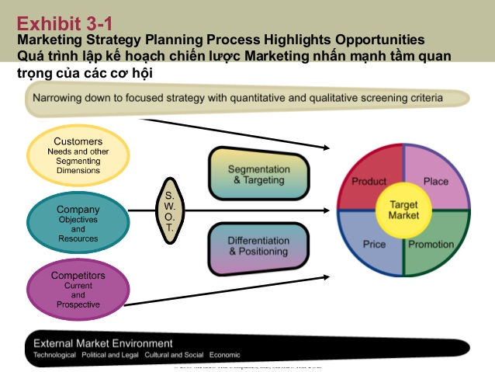
2.4 Marketing strategy planning process highlights opportunities

Slide 15
Segmentation: subgroups (segments) of customers who are similar and could be satisfied with the same marketing mix.
Positioning: refers to how customers think about proposed or present brands in a market
Differentiation: means that the marketing mix is distinct from and better than what is available from a competitor.
SWOT analysis: identifies and lists the firm’s strengths and weaknesses and its opportunities and threats.

Slide 16
Macro-environment:
Economic: inflation, interest rates, unemployment
Social/cultural: age distribution, lifestyle changes, values, attitudes
Technological: new product and process technologies, materials
Political/legal: monopoly control, new laws, regulations
Ecological: conservation, pollution, energy

Slide 17
Types of opportunities to pursue
Market
Existing
New/related
Market penetration
Existing
Market development
Products
New/related
Product development
Diversification

Slide 18
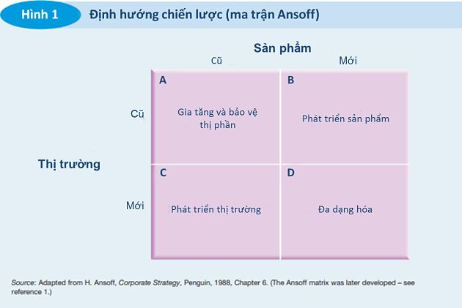

Slide 19
Market penetration: means trying to increase sales of a firm’s present products through a more aggressive marketing mix. The firm may try to strengthen its relationship with customers to increase their rate of use or repeat purchases
Market development: means trying to increase sales by selling present products in new markets. They may add channels of distribution or new stores in new areas including overseas
Notes:
Thâm nhập thị trường

Slide 20
Product development: means offering new or improved products for present markets. By knowing the present market’s needs, a firm may see new ways to satisfy customers.
Diversification: means moving into totally different lines of business (unfamiliar products, markets or production, marketing system)
For example: McDonald’s opened two hotels in Switzerland; Vin-group open supermarket, schools, hospital, car production; Lotte

Slide 21
Homework
1. Distinguish clearly between mass marketing and target marketing. Use an example
2. If a company sells its products only from a website, which is accessible over the Internet to customers from all over the world, does it still need to worry about having a specific target market? Explain your thinking
3. Explain why a firm may want to pursue a market penetration opportunity before pursuing one involving product development or diversification

